Slide 1


Slide 2

BUSTED AI: Intelligent Financial Shield For Fraud Detection
By FAIZAN QURESHI

Slide 3

Objective: To give the you a clear, engaging roadmap of our project. This isn't a boring list; it's a "journey."
The Problem : The scale and challenge of financial fraud.
Our ML Arsenal: The classic models that built our foundation.
The Performance Battle: How our ML models stacked up.
Entering the AI Arena: Why we evolved to Deep Learning.
The AI Powerhouse: Blueprint of our Neural Network architecture.
The Final Showdown: ML vs AI - A comparative analysis.
The Verdict & The Future: Conclusions and what's next.

Slide 4

A Billion-Dollar Battle in Milliseconds
The Scale: Financial fraud is a $30+ billion annual global problem.
The Speed: Fraudulent transactions happen in seconds, requiring real-time detection.
The Imbalance: Less than 1% of transactions are fraudulent, making it incredibly hard to find the "needle in a haystack."
The Consequence: Every missed fraud case means direct financial loss and eroded customer trust.

Slide 5

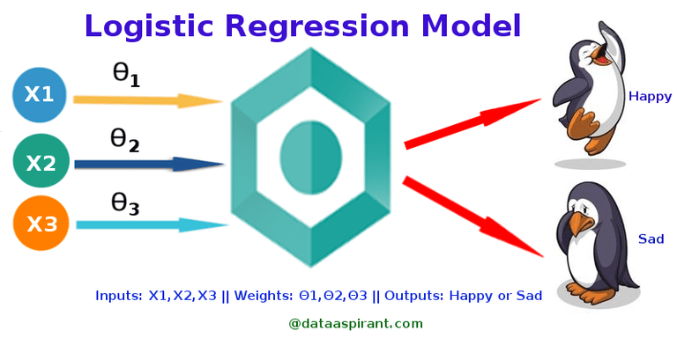
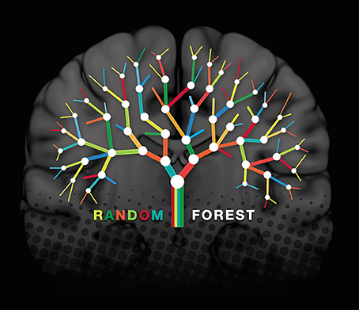
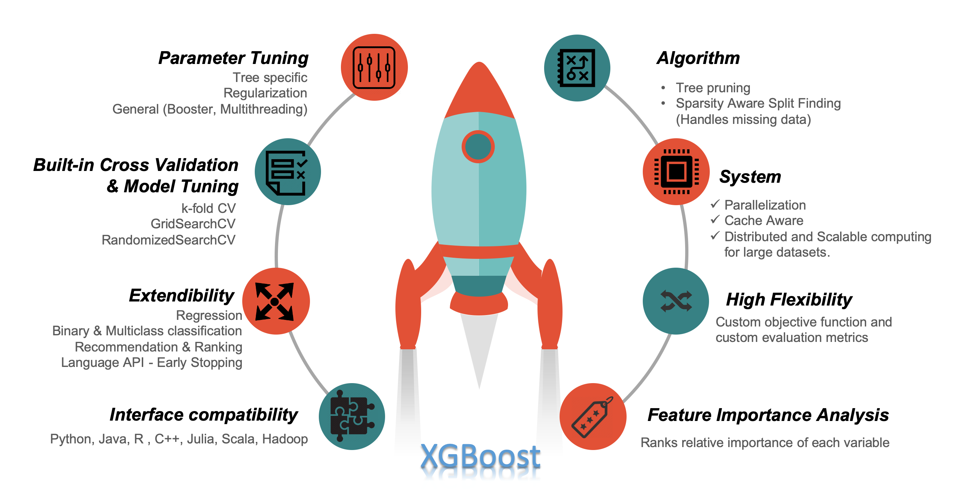
Building Our First Line of Defense
Logistic Regression The Interpretable Baseline
Fast & simple to implement
Sets a clear performance benchmark
Easy to explain to stakeholders
Random Forest The Robust Ensemble
Combines many decision trees
Reduces overfitting
Handles complex non-linear patterns well
XGBoost The Performance Champion
State-of-the-art for tabular data
Excellent accuracy & speed
Handles imbalanced data effectively
We tested multiple algorithms; these three formed our core ML arsenal.

Slide 6

The ML Model Showdown
🥉 Logistic Regression provided a strong, interpretable baseline.
🥈 Random Forest achieved perfect Precision (1.00) - zero false alarms.
🥈 XGBoost had the highest overall power - best at separating classes.
🏆 Both are Champions: Random Forest & XGBoost delivered nearly identical, top-tier F1-Scores.
Verdict: Our ML Arsenal is powerful. But with two top performers, the question becomes: Can AI break this tie and push the boundaries even further?

Slide 7

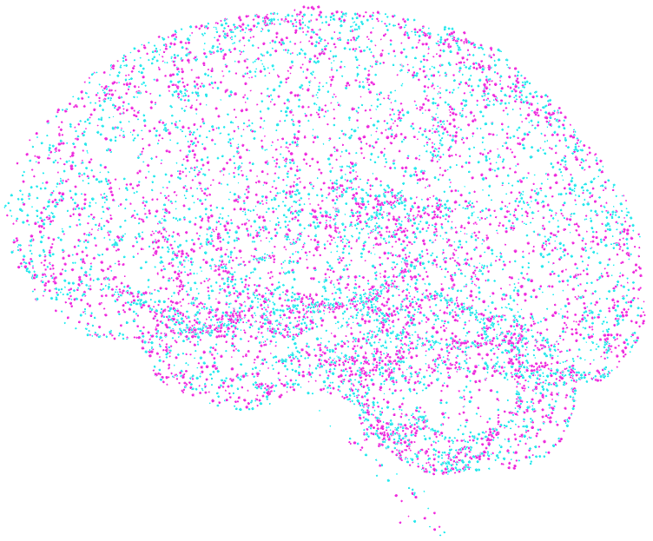
Entering the AI Arena
Beyond Traditional ML: Moving from manual feature engineering to automated pattern discovery
The AI Brain: A deep learning model that learns hierarchical representations
Why Neural Networks? To capture complex, non-linear relationships in transaction data
The Goal: Surpass our ML champions with more adaptive intelligence
"Training an AI brain to think like a fraud detection expert"

Slide 8

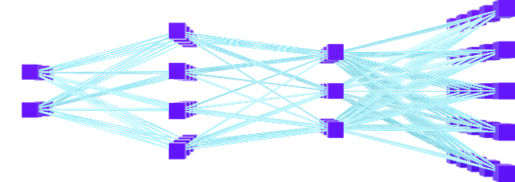
Inside the AI Brain
Input Layer: 31 neurons
Hidden Layers:
Layer 1: 64 neurons + ReLU activation
Layer 2: 32 neurons + ReLU activation
Output Layer: 1 neuron + Sigmoid activation
Loss Function: Binary Cross-Entropy
Optimizer: Adam
Epochs: 100
Batch Size: 32

Slide 9

The Final Showdown
Real-World Performance
Lab Metrics
Production Environment Results
AI Model: Better at catching sophisticated, never-before-seen fraud patterns
ML Models: Struggled with novel attack strategies
Key Insight: The Neural Network learned deeper conceptual patterns rather than just memorizing the training data
Our AI learned the "essence" of fraud, not just the patterns in our historical data.
Model | Precision | Recall | F1-Score
Random Forest | 1.00 | 0.98 | 0.99
XGBoost | 0.997 | 0.98 | 0.99
Neural Network | 1.00 | 0.42 | 0.59

Slide 10

The Final Verdict
For Standard Fraud Detection: ML Models (XGBoost/Random Forest) are incredibly reliable and efficient.
For Evolving & Sophisticated Threats: Our AI Neural Network is the strategic champion, learning the true essence of fraud.
We've built a dual-layered shield: ML for today's patterns, AI for tomorrow's threats.

Slide 11
QUESTIONS❓

Slide 12


